Slide 1
SOFTWARE DEVELOPMENT 3
Advanced Language Features
Static Methods & Variables

Slide 2
Static Methods
Sometimes we need a method that is not invoked on an object – we can use a static method or a class method
The other methods that we have written up to now are often called instance methods
Typical examples of static methods are the sqrt and pow methods in the Math class:
      > Math.sqrt(25)
      5.0
      > Math.pow(2, 10)
      1024.0

Slide 3
Static Methods
Why use a method that does not operate on an object?
Usually because we want to perform some computation that involves only numbers and because numbers are not objects, we cannot invoke methods on them

Slide 4
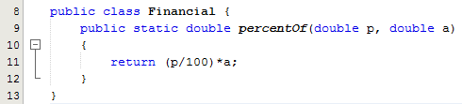
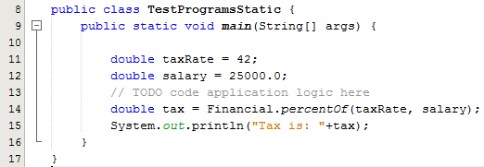
Example 1
This is a simple example of a static method that carries out some simple algebra: to compute p percent of the amount a
Because p and a are numbers, the method does not operate on any objects at all, so we create it as a static method – see the use of the static keyword on line 9
In the test class we want to call this method by using the name of the class so that the compiler can find it – see line 14
Notice that the main method is always static – there aren’t any objects when the program starts

Slide 5
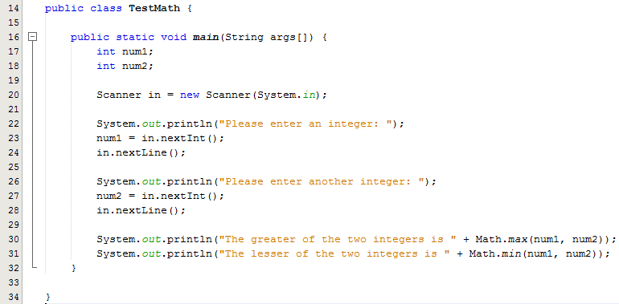
Example 2
Note the use of the static Math class and two of it’s static methods max() and min()

Slide 6
Static Methods
A static method cannot access non-static class members, because a static method can be called even when no objects of the class have been instantiated.
  For the same reason, the this reference cannot be used in a static method.
  The this reference must refer to a specific object of the class, and when a static method is called, there might not be any objects of its class in memory.

Slide 7
Static Variables
So far, all the instance variables we’ve created have been dynamic. That’s the default.
Dynamic means:
  One per instance/object
  Created at run-time
An object gets its own copy of each instance (dynamic) variable.
Note: There is no “dynamic” keyword in Java.
A static variable represents classwide information—all objects of the class share the same piece of data.

Slide 8
static Class Members (Cont.)
A static method cannot access non-static class members, because a static method can be called even when no objects of the class have been instantiated.
  For the same reason, the this reference cannot be used in a static method.
  The this reference must refer to a specific object of the class, and when a static method is called, there might not be any objects of its class in memory.
If a static variable is not initialized, the compiler assigns it a default value—in this case 0, the default value for type int.

Slide 9
Static Variables
A static variable that is public can be accessed via
  ClassName.variable
  Math.PI has a value of 3.141592653589793
If a static variable is not initialized, the compiler assigns it a default value—in this case 0, the default value for type int.

Slide 10
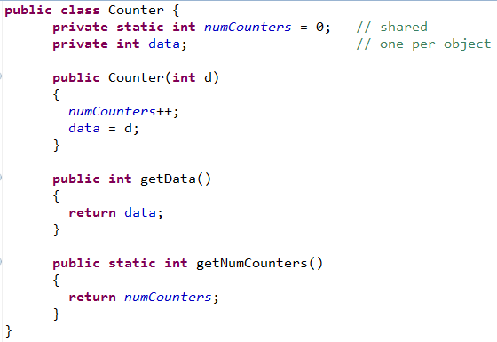
Example 1
Note the use of the keyword static

Slide 11
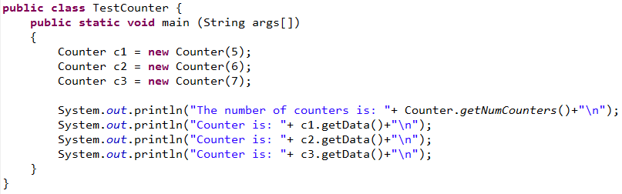
Example 1
The public static method is called by qualifying its name with the class name and a dot.

Slide 12
Final Static Fields
Sometimes a data field in a class should be constant
For example you might want to store a school roll number that is the same for every Student object your create, so you declare it to be static
In addition, if you want the value for the school roll number to be fixed so that all Student objects use the same roll number value, you use the keyword final to make the value unalterable after construction
See example on the next slide

Slide 13
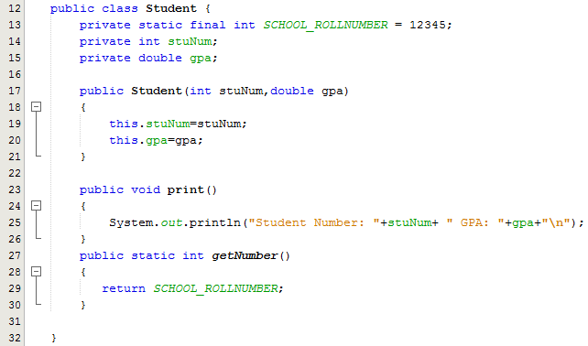
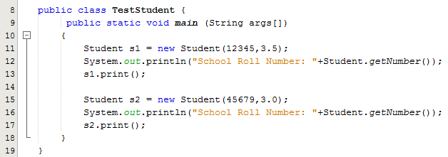
Example of static final
Line 13:
Note the use of the keywords static & final
Lines 27-30: A static getter method is used to access this field
TestProgram:
Lines 12 & 16: Note the calls to the static getter method
The same roll number applies to each student

Slide 14

Static Blocks
Static blocks are also known as Static initialization blocks .
These are normal blocks of code which are enclosed in braces, { }, and preceded by the keyword static.
Example:
Note the use of the keyword static and the curly braces {}

Slide 15
Static Blocks
A class can have any number of static blocks, which can be placed anywhere in the class body.
At runtime, these static blocks are called in the order that they appear in the source code.
Code in static blocks is executed when JVM loads the class. The JVM combines all these blocks into one single static block and then executes them.

Slide 16
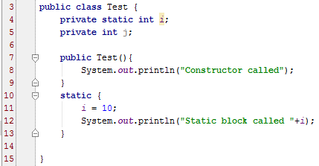
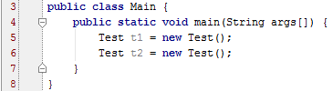

Static Blocks Example 1
Static blocks are executed before constructors
Although we have two objects in the test class, the static block is executed only once.
Sample Output

Slide 17
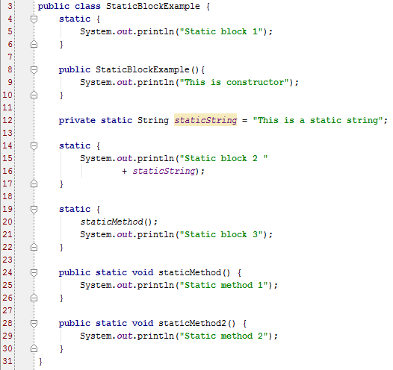
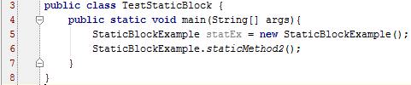
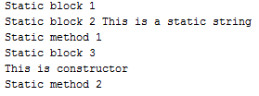
Static Blocks Example 2
When the test class is executed the code is executed in the following order:
StaticBlockExample Class: Lines 3-6,14-16, 20, 24-25, 19-21, Line 5 (In Test class), Lines 8-10, Line 6 (Test class), Lines 28-29
Sample Output

Slide 18
Static Blocks - Uses
Loading drivers and other items into the namespace
If you need to do computation in order to initialize your static variables, you can declare a static block which gets executed exactly once when the class is first loaded.
Namespaces are named program regions used to limit the scope of variables inside the program.
They are used in many programming languages to create a separate region for a group of variables, functions, classes, etc.
The usage of namespaces helps to avoid conflict with the existing definitions.
Namespaces provide a way of implementing information hidden.
Examples of namespaces in Java are classes and packages.

